Slide 1



Building Websites in R with Distill
By: Jenny Sloane
@jfsloane
https://jennysloane.netlify.app/
https://rgirls.org.uk/

Slide 2
Overview
Download necessary programs
1
Create GitHub Repo
2
Clone Repo
3
Create Distill Webiste in Rstudio
4
Customize Homepage
5
Push to GitHub
6
Additional Resources
7
*
Create Custom Color Theme

Slide 3




Download Necessary Programs
1
R installed
Windows: https://cran.r-project.org/bin/windows/base/
Mac: https://cran.r-project.org/bin/macosx/
R Studio installed: https://www.rstudio.com/products/rstudio/download/
Git installed: https://git-scm.com/downloads
GitHub – sign up: https://github.com
Notes:
https://git-scm.com/download/mac
Install homebrew
Open terminal copy and paste code from link above
To check that git is installed, in the console type git --version

Slide 4

Create GitHub Repo
2
Login to GitHub
Click on the New Repository button
Create repo
Repo name – important note: the name will end up being part of the URL of your website
Public
Add a readme file
Create repo

Slide 5
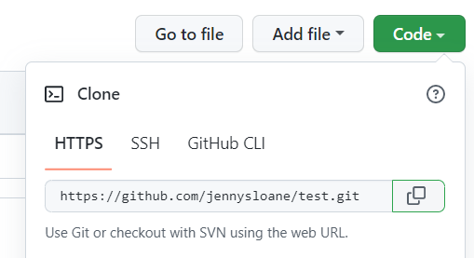
Clone Repo
3
Click the green code button copy URL
Open RStudio
Project New Project Version Control git Paste
Make sure to save your project in a safe place that you’ll remember
Create project

Slide 6
Create Distill Website
4
Install distill: install.packages(“distill”)
Load in distill library: library(distill)
Create website: create_website(dir = “.”, title = “TITLE”, gh_pages = TRUE)
Go to Files to see everything that has been created (e.g., site, index, about)
Before you can build your website, you will need to close and re-open RStudio
Navigate to the Build tab and click Build Website
You may have to install some packages

Slide 7
Customize Homepage
5
Choose your template: https://github.com/seankross/postcards
Delete index file (because we’ll create a new one)
Create new homepage: create_article(file = “index”, template = “trestles”, package = “postcards”)
Add one line of code to the index YAML:
site: distill::distill_website
Update YAML and main content on homepage
Add profile picture or logo
Update buttons (e.g., twitter, LinkedIn, etc.)

Slide 8
Push to GitHub
6
Create personal GitHub token
Install usethis package: install.packages(“usethis”)
usethis::create_github_token() (will be redirected to GitHub)
Login to github
Provide name (optional)
You can change the settings, but I usually keep the default
Select create token
Copy token
In the console in RStudio type: gitcreds::gitcreds_set()
Paste token when prompted

Slide 9
Push to GitHub
6
Push everything to GitHub
Stage
Tools shell
Git add –A (to add everything)
Close out and click commit and everything will be staged
Commit – click commit and leave a message as a reminder of the changes you’ve made
Push

Slide 10
Push to GitHub
6
Go to GitHub to see all the updates
In your repo, click settings pages (on left)
Select “main” branch
Select the “/docs” folder
May take some time for GitHub to build the website, but now you should have a link to your website!

Slide 11
Additional Resources
7
Dr. Maria Tackett: Building Websites in R
R-Girls Website GitHub Repository
My YouTube Playlist on Building Websites in R with Distill
YouTube Tutorial: Creating a Custom Color Theme
YouTube Tutorial: Setting up Navigation Bar and Creating a Single Page
YouTube Tutorial: Creating Posts (coming soon)

Slide 12
Create Custom Color Theme
*
create_theme(“custom-theme”) – this will create a css file
Site.yml add one line of code to the YAML: theme: custom-theme.css
Edit the css file
Change font
Import google fonts https://fonts.google.com/
Find the font you want use on the web select @import copy code in between the style tags
Paste code at the top of the css file
Choose color palette https://coolors.co/

Slide 13

Questions?
THANK YOU!!

